Slide 1

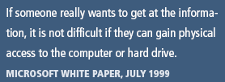
Principles of Information Security,
Fifth Edition
Chapter 9
Physical Security

Slide 2
Learning Objectives
Upon completion of this material, you should be able to:
  Discuss the relationship between information security and physical security
  Describe key physical security considerations, including fire control and surveillance systems
  Identify critical physical environment considerations for computing facilities, including uninterruptible power supplies
Principles of Information Security, Fifth Edition
Notes:
Learning Objectives
Upon completion of this material, you should be able to:
Discuss the relationship between information security and physical security
Describe key physical security considerations, including fire control and surveillance systems
Identify critical physical environment considerations for computing facilities, including uninterruptible power supplies

Slide 3
Introduction
Physical security involves the protection of physical items, objects, or areas from unauthorized access and misuse.
Most technology-based controls can be circumvented if an attacker gains physical access.
Physical security is as important as logical security.
Principles of Information Security, Fifth Edition
Notes:
Introduction
Physical security involves protection of physical items, objects, or areas from unauthorized access and misuse
Most technology-based controls can be circumvented if an attacker gains physical access
Physical security is as important as logical security

Slide 4
Introduction (cont’d)
Seven major sources of physical loss:
  Extreme temperature(heat,cold)
  Gases(war gases,commerical vapors,humid or dry air,suspended particles)
  Liquids(water,chemical)
  Livingorganisms(viruses,bacteria,people,animals,insects)
  Projectiles(tangible objects in motion,powered objects)
  Movement(collapse,shearing,shaking,vibration,liquefaction,flow waves,separation slide)
  Energy anomalies(electrical surge or failure,magnetism,aging circuitry,radiation,sound,light)
Principles of Information Security, Fifth Edition
Notes:
Seven Major Sources of Physical Loss
From Donn B. Parker
Extreme temperature: heat, cold
Gases: war gases, commercial vapors, humid or dry air, suspended particles
Liquids: water, chemicals
Living organisms: viruses, bacteria, people, animals, insects
Projectiles: tangible objects in motion, powered objects
Movement: collapse, shearing, shaking, vibration, liquefaction, flows waves, separation, slide
Energy anomalies: electrical surge or failure, magnetism, static electricity, aging circuitry; radiation: sound, light, radio, microwave, electromagnetic, atomic

Slide 5
Introduction (cont’d)
Community roles
  General management: responsible for facility security
  IT management and professionals: responsible for environmental and access security
  Information security management and professionals: perform risk assessments and implementation reviews
Principles of Information Security, Fifth Edition
Notes:
Introduction
Community roles
General management: responsible for facility security
IT management and professionals: responsible for environmental and access security
Information security management and professionals: perform risk assessments and implementation reviews

Slide 6
Physical Access Controls
Secure facility: physical location with controls implemented to minimize the risk of attacks from physical threats
Secure facility can take advantage of natural terrain, local traffic flow, and surrounding development and can complement these with protection mechanisms (fences, gates, walls, guards, alarms).
Principles of Information Security, Fifth Edition
Notes:
Physical Access Controls
Secure facility: physical location with controls implemented to minimize risk of attacks from physical threats
Secure facility can take advantage of natural terrain, local traffic flow, and surrounding development; can complement these with protection mechanisms (fences, gates, walls, guards, alarms)

Slide 7
Physical Security Controls
Walls, fencing, and gates
Guards
Dogs
ID cards and badges
Locks and keys
Mantraps
Electronic monitoring
Alarms and alarm systems
Computer rooms and wiring closets
Interior walls and doors
Principles of Information Security, Fifth Edition
Notes:
Controls for Protecting the Secure Facility
There are a number of physical security controls and issues that the organization’s communities of interest should consider together when implementing physical security:
Walls, fencing, and gates
Guards to apply human reasoning
Dogs to provide their keen sense of smell and hearing and to be placed in harm’s way in lieu of humans
ID cards and badges
Locks and keys
Mantraps
Electronic monitoring
Alarms and alarm systems
Computer rooms
Walls and doors

Slide 8
Physical Security Controls (cont’d)
Walls, Fencing, and Gates
  Some of the oldest and most reliable elements of physical security; the essential starting point for perimeter control
Guards
  Can evaluate each situation as it arises to make reasoned responses; most have standard operating procedures
Dogs
  Keen sense of smell and hearing can detect intrusions that human guards cannot
Principles of Information Security, Fifth Edition
Notes:
Physical Security Controls
Walls, Fencing, and Gates
Some of the oldest and most reliable elements of physical security; essential starting point for perimeter control
Guards
Can evaluate each situation as it arises to make reasoned responses; most have standard operating procedures
Dogs
Keen sense of smell and hearing can detect intrusions human guards cannot

Slide 9
Physical Security Controls (cont’d)
ID Cards and Badges
  ID card is typically concealed and name badge is visible.
  Serve as a simple form of biometrics (facial recognition)
  Should not be the only means of control as cards can be easily duplicated, stolen, and modified
  Tailgating occurs when an authorized individual opens a door and other people also enter.
Principles of Information Security, Fifth Edition
Notes:
ID Cards and Badges
ID card is typically concealed; name badge is visible
Serve as simple form of biometrics (facial recognition)
Should not be only means of control as cards can be easily duplicated, stolen, and modified
Tailgating occurs when authorized individual opens a door and other people also enter

Slide 10
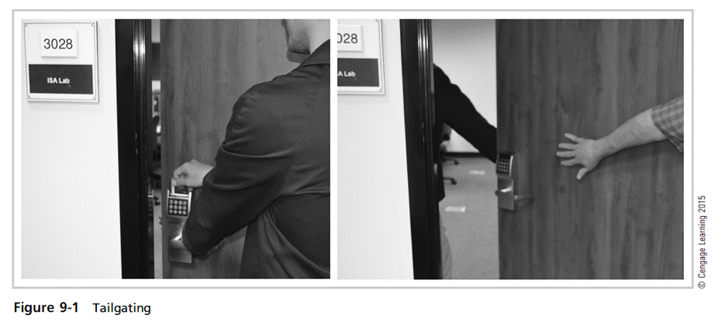
Principles of Information Security, Fifth Edition

Slide 11
Physical Security Controls (cont’d)
Locks and keys
  Two types of locks: mechanical and electromechanical
  Locks can also be divided into four categories: manual, programmable, electronic, biometric
  Locks fail and alternative procedures for controlling access must be put in place.
  Locks fail in one of two ways:
    Fail-safe lock
    Fail-secure lock
Principles of Information Security, Fifth Edition
Notes:
Locks and Keys
Two types of locks: mechanical and electromechanical
Locks can also be divided into four categories: manual, programmable, electronic, biometric
Locks fail and alternative procedures for controlling access must be put in place
Locks fail in one of two ways:
Fail-safe lock
Fail-secure lock

Slide 12
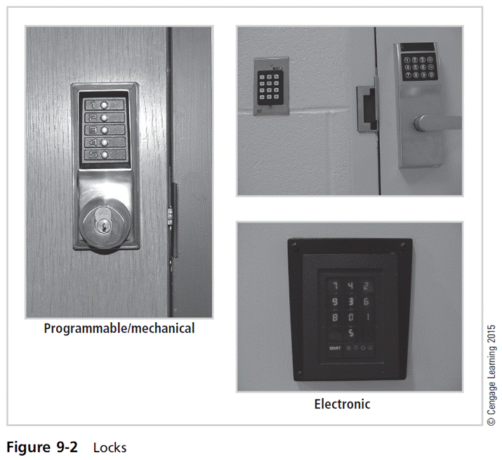
Principles of Information Security, Fifth Edition

Slide 13
Physical Security Controls (cont’d)
Mantraps
  Small enclosure that has an entry point and a different exit point
  Individual enters mantrap, requests access, and, if verified, is allowed to exit mantrap into facility.
  Individual denied entry is not allowed to exit until the security official overrides automatic locks of the enclosure.
Principles of Information Security, Fifth Edition
Notes:
Mantraps
Small enclosure that has entry point and different exit point
Individual enters mantrap, requests access, and, if verified, is allowed to exit mantrap into facility
Individual denied entry is not allowed to exit until security official overrides automatic locks of the enclosure

Slide 14
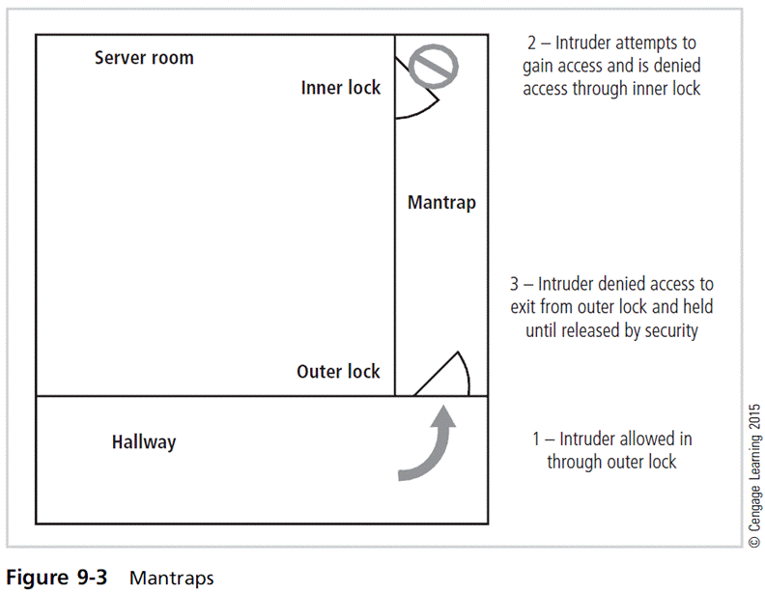
Principles of Information Security, Fifth Edition

Slide 15
Physical Security Controls (cont’d)
Electronic Monitoring
  Equipment can record events in areas where other types of physical controls are impractical.
  May use cameras with video recorders; includes closed-circuit television (CCT) systems
  Drawbacks
    Passive; does not prevent access or prohibited activity
    Recordings often are not monitored in real time; must be reviewed to have any value
Principles of Information Security, Fifth Edition
Notes:
Electronic Monitoring
Equipment can record events in areas where other types of physical controls are impractical
May use cameras with video recorders; includes closed-circuit television (CCT) systems
Drawbacks
Passive; does not prevent access or prohibited activity
Recordings often are not monitored in real time; must be reviewed to have any value

Slide 16
Physical Security Controls (cont’d)
Alarms and alarm systems
  Alarm systems notify people/systems when an event occurs.
  Detect fire, intrusion, environmental disturbance, or an interruption in services
  Rely on sensors that detect an event, for example, motion detectors, thermal detectors, glass breakage detectors, weight sensors, and contact sensors
Principles of Information Security, Fifth Edition
Notes:
Alarms and Alarm Systems
Alarm systems notify people/systems when an event occurs
Detect fire, intrusion, environmental disturbance, or an interruption in services
Rely on sensors that detect event; e.g., motion detectors, thermal detectors, glass breakage detectors, weight sensors, contact sensors

Slide 17
Physical Security Controls (cont’d)
Computer rooms and wiring closets
  Require special attention to ensure confidentiality, integrity, and availability of information
  Logical access controls are easily defeated if attacker gains physical access to computing equipment.
  Custodial staff, often the least scrutinized people who have access to offices, are given greatest degree of unsupervised access.
Principles of Information Security, Fifth Edition
Notes:
Computer Rooms and Wiring Closets
Require special attention to ensure confidentiality, integrity, and availability of information
Logical access controls easily defeated if attacker gains physical access to computing equipment
Custodial staff often the least scrutinized people who have access to offices; are given greatest degree of unsupervised access

Slide 18
Physical Security Controls (cont’d)
Interior walls and doors
  Information asset security is sometimes compromised by improper construction of facility walls and doors.
  Facility walls are typically either standard interior or firewall.
  High-security areas must have firewall-grade walls to provide physical security against potential intruders and fires.
  Doors allowing access to high-security rooms should be evaluated.
  To secure doors, install push or crash bars on computer rooms and closets.
Principles of Information Security, Fifth Edition
Notes:
Interior Walls and Doors
Information asset security sometimes compromised by improper construction of facility walls and doors
Facility walls typically either standard interior or firewall
High-security areas must have firewall-grade walls to provide physical security against potential intruders and fires
Doors allowing access to high security rooms should be evaluated
To secure doors, install push or crash bars on computer rooms and closets

Slide 19
Fire Security and Safety
Most serious threat to safety of people who work in an organization is fire.
Fires account for more property damage, personal injury, and death than any other threat.
It is imperative that physical security plans implement strong measures to detect and respond to fires and fire hazards.
Principles of Information Security, Fifth Edition
Notes:
Fire Safety
Most serious threat to safety of people who work in an organization is fire
Fires account for more property damage, personal injury, and death than any other threat
Imperative that physical security plans implement strong measures to detect and respond to fires and fire hazards

Slide 20
Fire Detection and Response
Fire suppression systems: devices installed and maintained to detect and respond to a fire, potential fire, or combustion danger
Flame point: temperature of ignition
Deny an environment of temperature, fuel, or oxygen
  Water and water mist systems
  Carbon dioxide systems
  Soda acid systems
  Gas-based systems
Principles of Information Security, Fifth Edition
Notes:
Fire Detection and Response
Fire suppression systems: devices installed and maintained to detect and respond to a fire, potential fire, or combustion danger
Flame point: temperature of ignition
Deny an environment of temperature, fuel, or oxygen
Water and water mist systems
Carbon dioxide systems
Soda acid systems
Gas-based systems

Slide 21
Fire Detection and Response (cont’d)
Fire detection
  Fire detection systems fall into two general categories: manual and automatic
  To prevent an attacker slipping into offices during an evacuation, programs often designate a person from each office area to serve as a floor monitor.
  There are three basic types of fire detection systems: thermal detection, smoke detection, flame detection
Principles of Information Security, Fifth Edition
Notes:
Fire Detection
Fire detection systems fall into two general categories: manual and automatic
To prevent attacker slipping into offices during an evacuation, programs often designate a person from each office area to serve as a floor monitor
There are three basic types of fire detection systems: thermal detection, smoke detection, flame detection

Slide 22
Fire Detection and Response (cont’d)
Fire suppression
  Systems can consist of portable, manual, or automatic apparatus.
  Portable extinguishers are rated by the type of fire: Class A, Class B, Class C, Class D, Class K.
  Installed systems apply suppressive agents, usually either sprinkler or gaseous systems.
Principles of Information Security, Fifth Edition
Notes:
Fire Suppression
Fire suppression systems can consist of portable, manual, or automatic apparatus. Portable extinguishers are rated by the type of fire:
Class A: Fires of ordinary combustible fuels. Use water and multipurpose, dry chemical fire extinguishers.
Class B: Fires fueled by combustible liquids or gases, such as solvents, gasoline, paint, lacquer, and oil. Use carbon dioxide, multipurpose dry chemical, and halon fire extinguishers.
Class C: Fires with energized electrical equipment or appliances. Use carbon dioxide, multi-purpose dry chemical, and halon fire extinguishers.
Class D: Fires fueled by combustible metals, such as magnesium, lithium, and sodium. Use special extinguishing agents and techniques.
Manual and automatic fire response can include installed systems designed to apply suppressive agents. These are usually either sprinkler or gaseous systems.
All sprinkler systems are designed to apply liquid, usually water, to all areas in which a fire has been detected.
In sprinkler systems, the organization can implement wet-pipe, dry-pipe, or pre-action systems.
Water mist sprinklers are the newest form of sprinkler systems and rely on ultra fine mists instead of traditional shower-type systems.

Slide 23
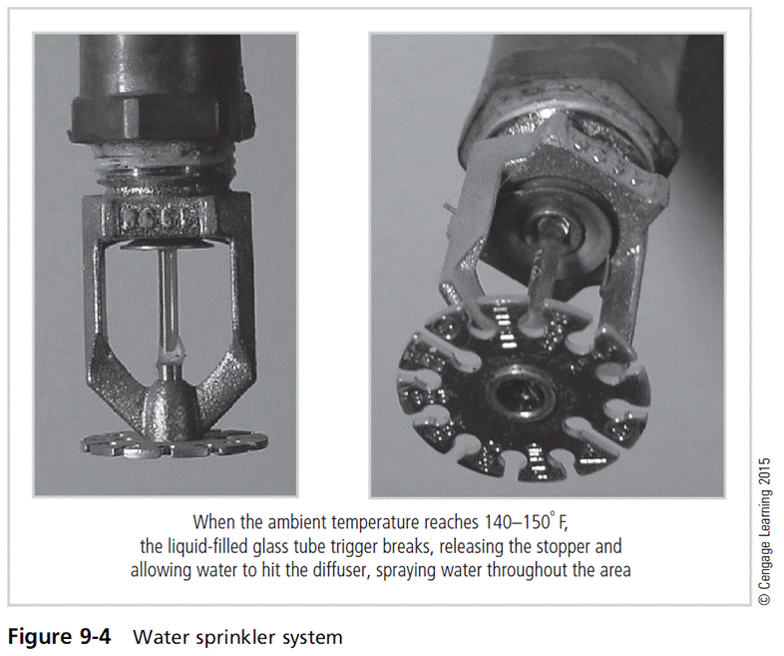
Principles of Information Security, Fifth Edition

Slide 24
Fire Detection and Response (cont’d)
Gaseous emission systems
  Until recently, two types of systems: carbon dioxide
  and Halon
  Carbon dioxide removes fire’s oxygen supply.
  Halon is clean but has been classified as an ozone-depleting substance; new installations are prohibited.
  Alternative clean agents presented in Table 9-1 (found on pages 484-485 in the text) are reported to be less effective than Halon.
Principles of Information Security, Fifth Edition
Notes:
Gaseous Emission Systems
Until recently, two types of systems: carbon dioxide
and Halon
Carbon dioxide removes fire’s oxygen supply
Halon is clean but has been classified as an ozone-depleting substance; new installations are prohibited
Alternative clean agents presented in Table 9-1, reported to be less effective than Halon

Slide 25
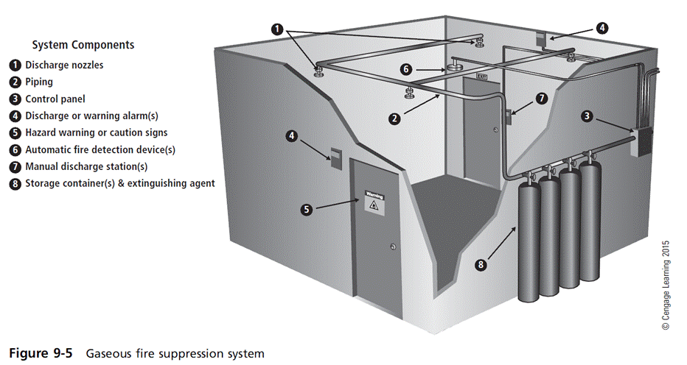
Principles of Information Security, Fifth Edition

Slide 26
Failure of Supporting Utilities and
Structural Collapse
Supporting utilities (heating, ventilation, and air conditioning; power; water) have significant impact on continued safe operation of a facility.
Each utility must be properly managed to prevent potential damage to information and information systems.
Principles of Information Security, Fifth Edition
Notes:
Failure of Supporting Utilities and Structural Collapse
Supporting utilities (heating, ventilation, and air conditioning; power; water) have significant impact on continued safe operation of a facility
Each utility must be properly managed to prevent potential damage to information and information systems

Slide 27
Heating, Ventilation, and Air Conditioning
Areas within heating, ventilation, and air conditioning (HVAC) systems that can cause damage to information systems include:
  Temperature
  Filtration
  Humidity
  Static electricity
Principles of Information Security, Fifth Edition
Notes:
Heating, Ventilation, and Air Conditioning
Although traditionally a facilities management responsibility, the operation of the heating, ventilation, and air conditioning (HVAC) system can have dramatic impact on information and information systems operations and protection.
Specifically there are four areas within the HVAC system that can cause damage to information-carrying systems: temperature, filtration, humidity, and static electricity.
Temperature
Computer systems are electronic and as such are subject to damage from extreme temperature.
Rapid changes in temperature, from hot to cold, or from cold to hot can produce condensation, which can create short circuits or otherwise damage systems and components.
The optimal temperature for a computing environment (and people) is between 70 and 74 degrees Fahrenheit.
Humidity
Humidity is the amount of moisture in the air.
High humidity levels create condensation problems, and low humidity levels can increase the amount of static electricity in the environment.
With condensation comes the short-circuiting of electrical equipment and the potential for mold and rot in paper-based information storage.
Static
Static electricity is caused by a process called triboelectrification, which occurs when two materials are rubbed or touched and electrons are exchanged, resulting in one object becoming more positively changed and the other more negatively charged.
When a third object with an opposite charge or ground is encountered, electrons flow again and a spark is produced.
One of the leading causes of damage to sensitive circuitry is electro-static discharge (ESD).
Static
Integrated circuits in a computer use between two and five volts of electricity.
Voltage levels as low as 200 can cause microchip damage.
Static electricity is not even noticeable to humans until levels approach 1,500 volts, and you can’t see the little blue spark until it approaches 4,000 volts.
A person can generate up to 12,000 volts of static current by walking across a carpet.
Static
Two types of failures can result from ESD damage to chips. Immediate failures, also known as catastrophic failures, occur right away and are usually totally destructive.
Latent failures or delayed failures can occur weeks or even months after the damage is done.
It is imperative to maintain the optimal level of humidity, which is between 40 and 60 percent in the computing environment. Humidity levels below this range create static, and levels above create condensation.

Slide 28
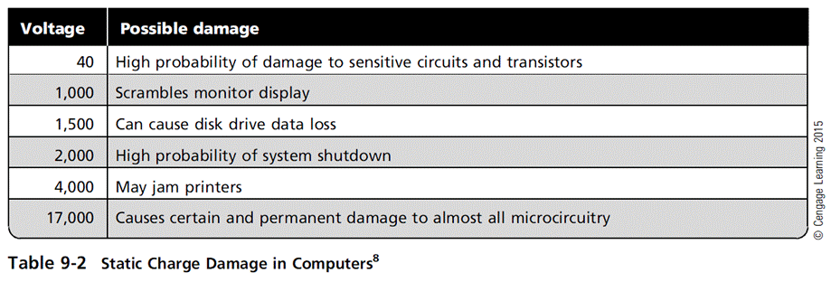
Principles of Information Security, Fifth Edition

Slide 29
Heating, Ventilation, and Air Conditioning (cont’d)
Ventilation shafts
  While ductwork is small in residential buildings, in large commercial buildings it can be large enough for an individual to climb through.
  If ducts are large, security can install wire mesh grids at various points to compartmentalize the runs.
Principles of Information Security, Fifth Edition
Notes:
Ventilation Shafts
While ductwork is small in residential buildings, in large commercial buildings it can be large enough for an individual to climb though
If ducts are large, security can install wire mesh grids at various points to compartmentalize the runs

Slide 30
Heating, Ventilation, and Air Conditioning (cont’d)
Power management and conditioning
  Power systems used by information-processing equipment must be properly installed and correctly grounded.
  Noise that interferes with the normal 60 Hertz cycle can result in inaccurate time clocks or unreliable internal clocks inside CPU.
Principles of Information Security, Fifth Edition
Notes:
Power Management and Conditioning
Power systems used by information-processing equipment must be properly installed and correctly grounded
Noise that interferes with the normal 60 Hertz cycle can result in inaccurate time clocks or unreliable internal clocks inside CPU

Slide 31
Heating, Ventilation, and Air Conditioning (cont’d)
Grounding and amperage
  Grounding ensures that returning flow of current is properly discharged to ground
  GFCI: capable of quickly identifying and interrupting a ground fault
  Overloading a circuit can create a load exceeding electrical cable’s rating, increasing the risk of overheating and fire.
Principles of Information Security, Fifth Edition
Notes:
Grounding and amperage
Grounding ensures that returning flow of current is properly discharged to ground
GFCI: capable of quickly identifying and interrupting a ground fault
Overloading a circuit can create a load exceeding electrical cable’s rating, increasing risk of overheating and fire

Slide 32
Heating, Ventilation, and Air Conditioning (cont’d)
Uninterruptible power supply (UPS)
  In case of power outage, UPS is the backup power source for major computing systems.
  Basic UPS configurations:
    Standby
    Line-interactive
    Standby online hybrid
    Standby ferroresonant
    Double conversion online
    Data conversion online
Principles of Information Security, Fifth Edition
Notes:
Uninterruptible power supply (UPS)
In case of power outage, UPS is backup power source for major computing systems
Basic UPS configurations:
Standby
Line-interactive
Standby online hybrid
Standby erroresonant
Double conversion online
Data conversion online

Slide 33
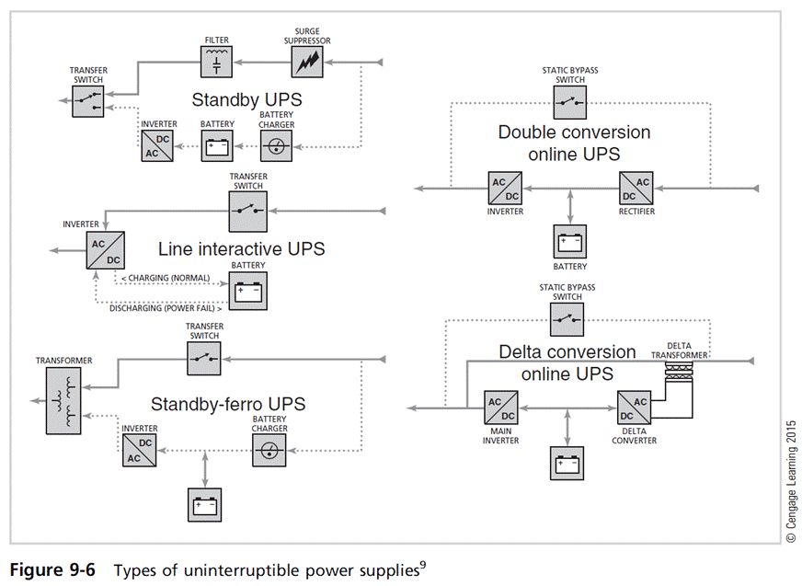
Principles of Information Security, Fifth Edition

Slide 34
Heating, Ventilation, and Air Conditioning (cont’d)
Emergency shutoff
  Important aspect of power management is the ability to stop power immediately if the current represents a risk to human or machine safety.
  Most computer rooms and wiring closets are equipped with an emergency power shutoff.
Principles of Information Security, Fifth Edition
Notes:
Emergency Shutoff
Important aspect of power management is ability to stop power immediately if the current represents a risk to human or machine safety
Most computer rooms and wiring closets are equipped with an emergency power shutoff

Slide 35
Water Problems
Lack of water poses problem to systems, including fire suppression and air-conditioning systems.
Surplus of water, or water pressure, poses a real threat (flooding, leaks).
Very important to integrate water detection systems into alarm systems that regulate overall facility operations
Principles of Information Security, Fifth Edition
Notes:
Water Problems
Lack of water poses problem to systems, including fire suppression and air-conditioning systems
Surplus of water, or water pressure, poses a real threat (flooding, leaks)
Very important to integrate water detection systems into alarm systems that regulate overall facility operations

Slide 36
Structural Collapse
Unavoidable environmental factors/forces can cause failures in structures that house an organization.
Structures are designed and constructed with specific load limits; overloading these limits results in structural failure and potential injury or loss of life.
Periodic inspections by qualified civil engineers assist in identifying potentially dangerous structural conditions.
Principles of Information Security, Fifth Edition
Notes:
Structural Collapse
Unavoidable environmental factors/forces can cause failures in structures that house organization
Structures designed and constructed with specific load limits; overloading these limits results in structural failure and potential injury or loss of life
Periodic inspections by qualified civil engineers assist in identifying potentially dangerous structural conditions

Slide 37
Maintenance of Facility Systems
Physical security must be constantly documented, evaluated, and tested.
Documentation of facility’s configuration, operation, and function should be integrated into disaster recovery plans and standard operating procedures.
Testing helps improve the facility’s physical security and identify weak points.
Principles of Information Security, Fifth Edition
Notes:
Maintenance of Facility Systems
Physical security must be constantly documented, evaluated, and tested
Documentation of facility’s configuration, operation, and function should be integrated into disaster recovery plans and standard operating procedures
Testing helps improve the facility’s physical security and identify weak points

Slide 38
Interception of Data
Three methods of data interception:
  Direct observation
  Interception of data transmission
  Electromagnetic interception
U.S. government developed TEMPEST program to reduce the risk of electromagnetic radiation (EMR) monitoring.
Principles of Information Security, Fifth Edition
Notes:
Interception of Data
Three methods of data interception:
Direct observation
Interception of data transmission
Electromagnetic interception
U.S. government developed TEMPEST program to reduce risk of electromagnetic radiation (EMR) monitoring

Slide 39
Securing Mobile and Portable Systems
Mobile computing requires more security than typical computing infrastructures on the organization’s premises.
Many mobile computing systems
  Have corporate information stored within them
  Some are configured to facilitate user’s access into organization’s secure computing facilities.
Principles of Information Security, Fifth Edition
Notes:
Securing Mobile and Portable Systems
Mobile computing requires more security than typical computing infrastructures on organization’s premises
Many mobile computing systems
Have corporate information stored within them
Some are configured to facilitate user’s access into organization’s secure computing facilities

Slide 40
Securing Mobile and Portable Systems (cont’d)
Controls support security and retrieval of lost or stolen laptops
  CompuTrace software, stored on laptop; reports to a central monitoring center
  Burglar alarms are made up of a PC card that contains a motion detector.
Principles of Information Security, Fifth Edition
Notes:
Securing Mobile and Portable Systems (continued)
Controls support security and retrieval of lost or stolen laptops
CompuTrace software, stored on laptop; reports to a central monitoring center
Burglar alarms made up of a PC card that contains a motion detector

Slide 41
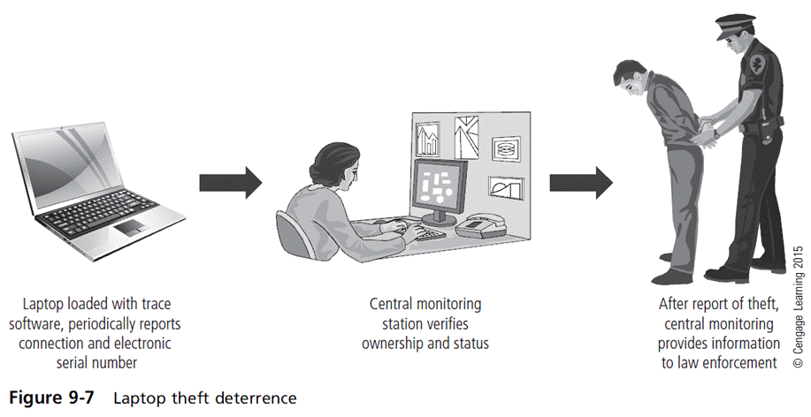
Principles of Information Security, Fifth Edition

Slide 42
Remote Computing Security
Remote site computing involves variety of computing sites outside the organization’s main facility.
Telecommuting: off-site computing using Internet, dial-up, or leased point-to-point links
Employees may need to access networks on business trips; telecommuters need access from home systems or satellite offices.
Telecommuter’s computers must be made more secure than organization’s systems.
Principles of Information Security, Fifth Edition
Notes:
Remote Computing Security
Remote site computing involves variety of computing sites outside organization’s main facility
Telecommuting: off-site computing using Internet, dial-up, or leased point-to-point links
Employees may need to access networks on business trips; telecommuters need access from home systems or satellite offices
Telecommuter’s computers must be made more secure than organization’s systems

Slide 43
Special Considerations for Physical
Security Threats
Develop physical security in-house or outsource?
  Many qualified and professional agencies
  Benefit of outsourcing includes gaining experience and knowledge of agencies.
  Downside includes high expense, loss of control over individual components, and level of trust that must be placed in another company.
Social engineering: use of people skills to obtain information from employees that should not be released
Principles of Information Security, Fifth Edition
Notes:
Special Considerations for Physical Security Threats
Develop physical security in-house or outsource?
Many qualified and professional agencies
Benefit of outsourcing includes gaining experience and knowledge of agencies
Downside includes high expense, loss of control over individual components, and level of trust that must be placed in another company
Social engineering: use of people skills to obtain information from employees that should not be released

Slide 44
Inventory Management
Computing equipment should be inventoried and inspected on a regular basis.
Classified information should also be inventoried and managed.
Physical security of computing equipment, data storage media, and classified documents varies for each organization.
Principles of Information Security, Fifth Edition
Notes:
Inventory Management
As with other organizational resources, computing equipment should be inventoried and inspected on a regular basis. Similarly classified information should also be inventoried and managed.
Whenever a classified document is reproduced, a stamp should be placed on the original before it is copied.
This stamp states the document’s classification level and document number for tracking.
Each classified copy is issued to its receiver, who signs for the document.

Slide 45
Summary
Threats to information security that are unique to
physical security
Key physical security considerations in a facility site
Physical security monitoring components
Essential elements of access control
Fire safety, fire detection, and response
Importance of supporting utilities, especially use of uninterruptible power supplies
Countermeasures to physical theft of computing devices
Principles of Information Security, Fifth Edition

